Slide 1
Food Consumption Trends in the United States: The Baseline for a Reimagined Localized Food System
Tiffanie F. Stone
EEOB590A Final Presentation

Slide 2
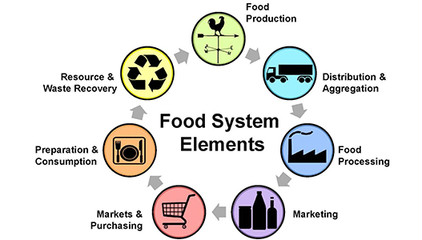
Introduction: Imagining a Localized Food Systems
Agricultural production alone makes up 19 -29% of anthropogenic greenhouse gas emissions (Vermeulen, Campbell, & Ingram, 2012)
Today: more than 50% of the global population live in urban areas
By 2050, urban populations are predicted to reach 70% (Kulak, Graves, & Chatterton, 2013)
Average grocery store items travel 1500 miles from farm to consumer (Knight & Riggs, 2010)
Understanding a city-scale food system
Source: texaslocalfood.org

Slide 3
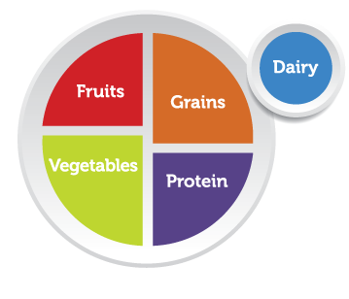
Introduction
Establish a baseline for food consumption patterns over time.
Used USDA National Food Consumption data
Mean and 95% confidence intervals
Nutrition inequity: Analyzing trends in low- and high-income populations
Understand food group trends and acknowledge them in food system models.

Slide 4
Methods: Part 1
Predictors:
Income Levels
Low
Average
High
Years
1994 – 1998
2003 – 2004
2005 – 2006
2007 – 2008
Response: food category consumed (lbs) / year
Fruits
Vegetables
Meat
Dairy
Grain
Oil

Slide 5
Methods: Part 2
Simulated vegetable consumption data using mean and 95% confidence intervals which were converted to standard deviations
6000 total data points – similar to 5000 participants in the survey for vegetable consumption (lbs/year)
2000 per income level
1500 per year

Slide 6
Simulated Vegetable Data Exploration
Compared three modeling approaches in data exploration:
Experimental Approach – removing non-significant interactions until remaining variables are significant
Fit-Full Model – no model selection – remove non-significant interactions
AIC/BIC – theoretical approach without p-values
Interactions between income level and year were not significant and were thus excluded from the final model selected

Slide 7
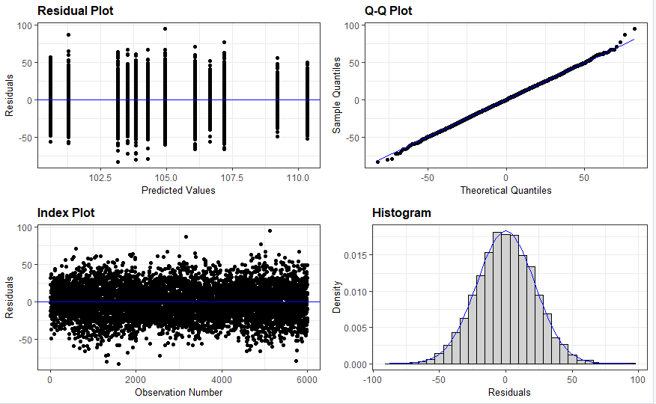
Simulated Vegetable Data Statistical Analysis
Assessed significance using p-values
Used lm (linear model) – response was normally distributed based on results from the resid_panel

Slide 8
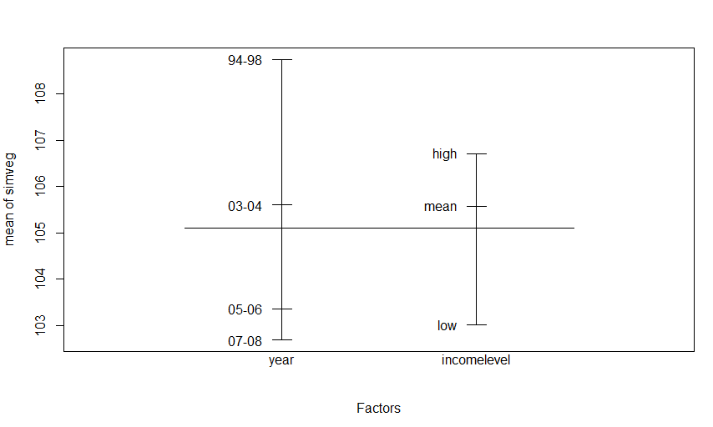
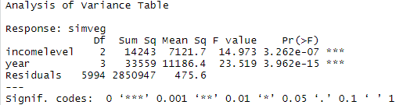
Simulated Vegetable Data Statistical Analysis vegsimmod2a = lm(simveg ~ incomelevel+year, data=vegsim)
Both year and income level were significant according to the linear model
Large sample size
Code: lm, plot.design, anova

Slide 9
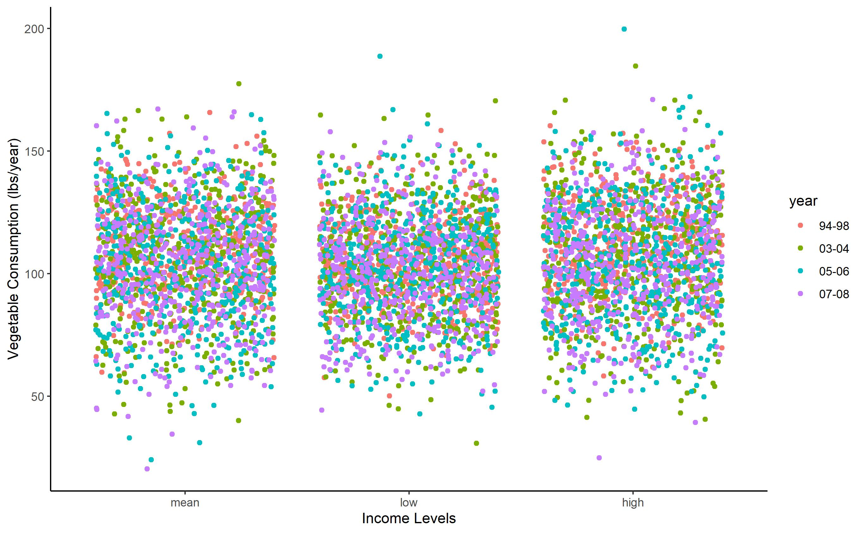
Simulated Vegetable Data

Slide 10
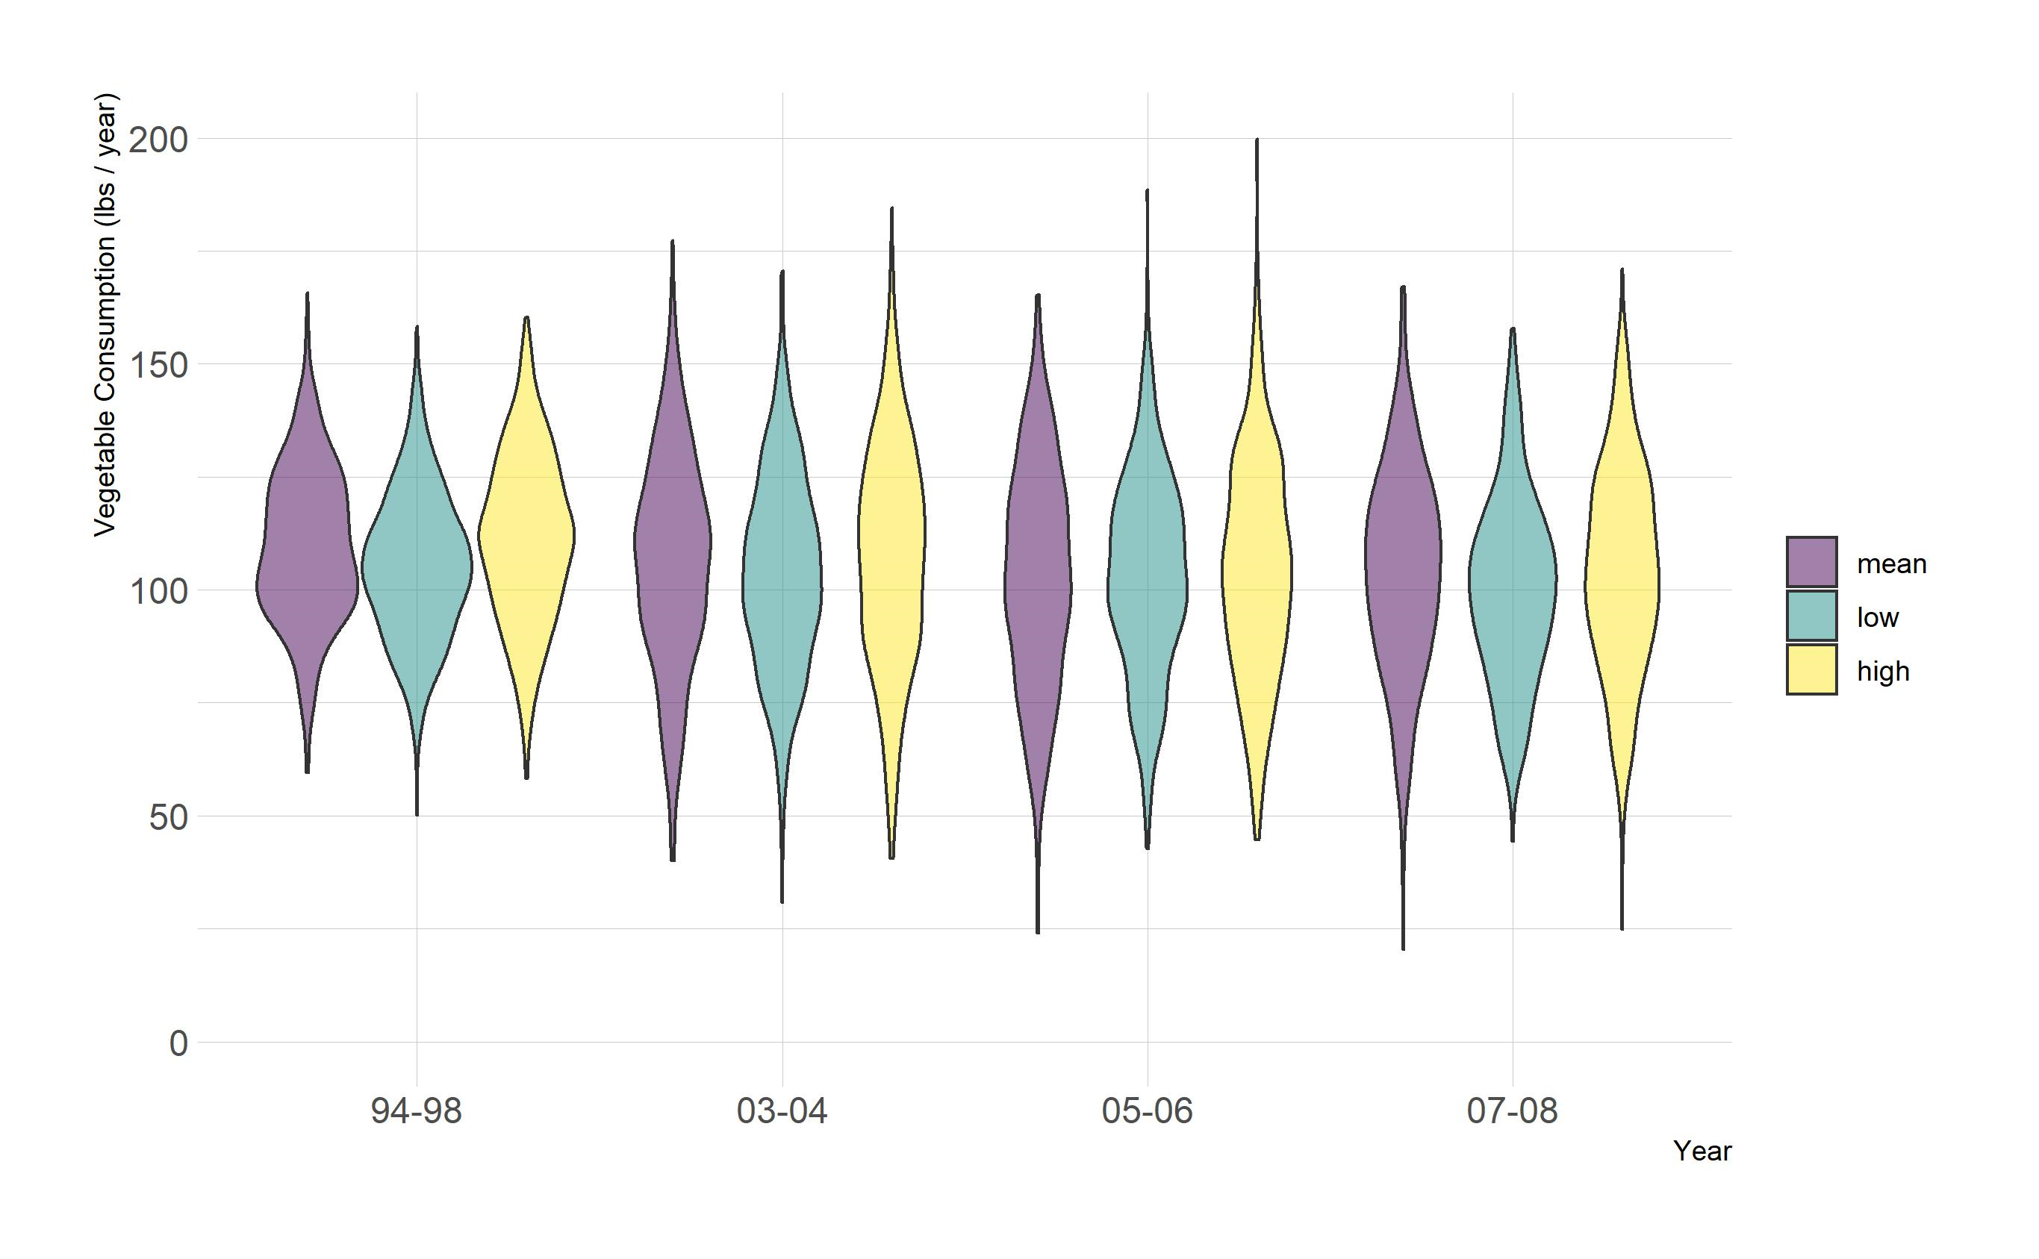
Simulated Vegetable Data

Slide 11
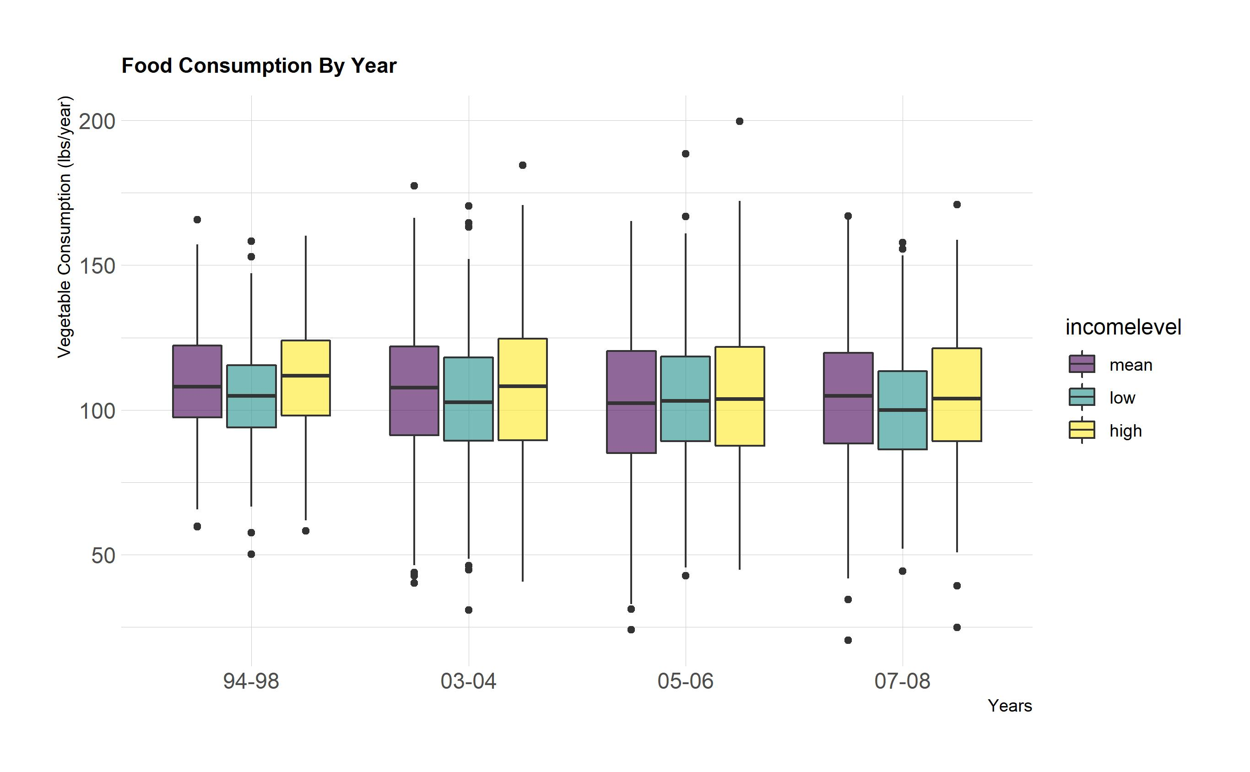

Slide 12
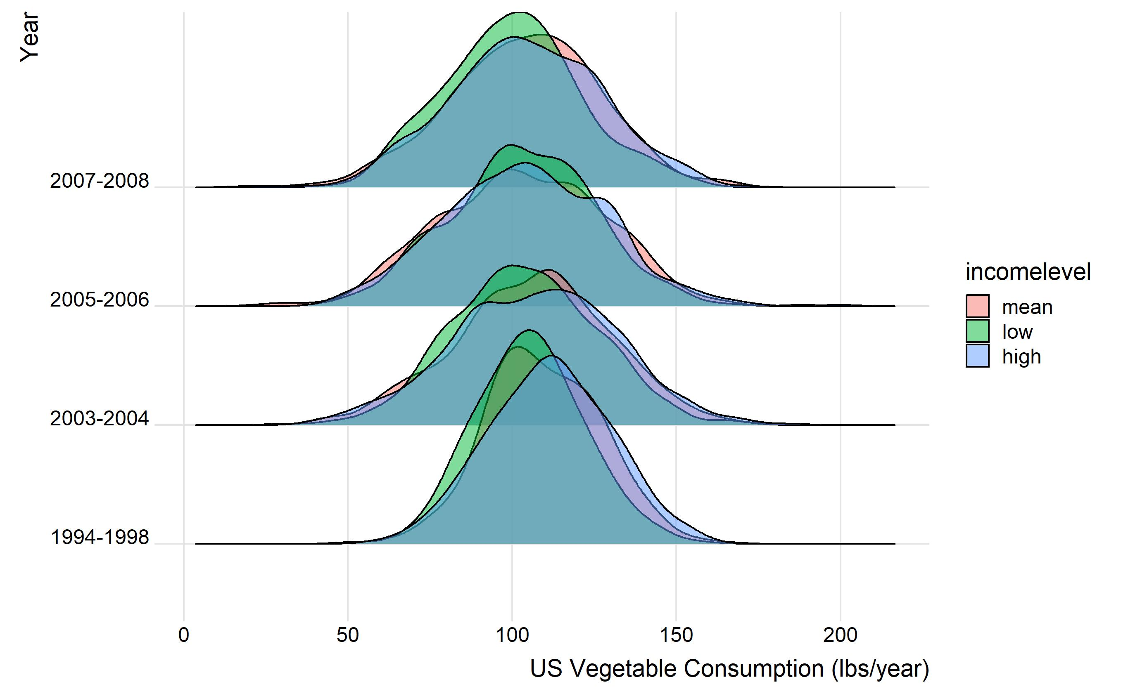
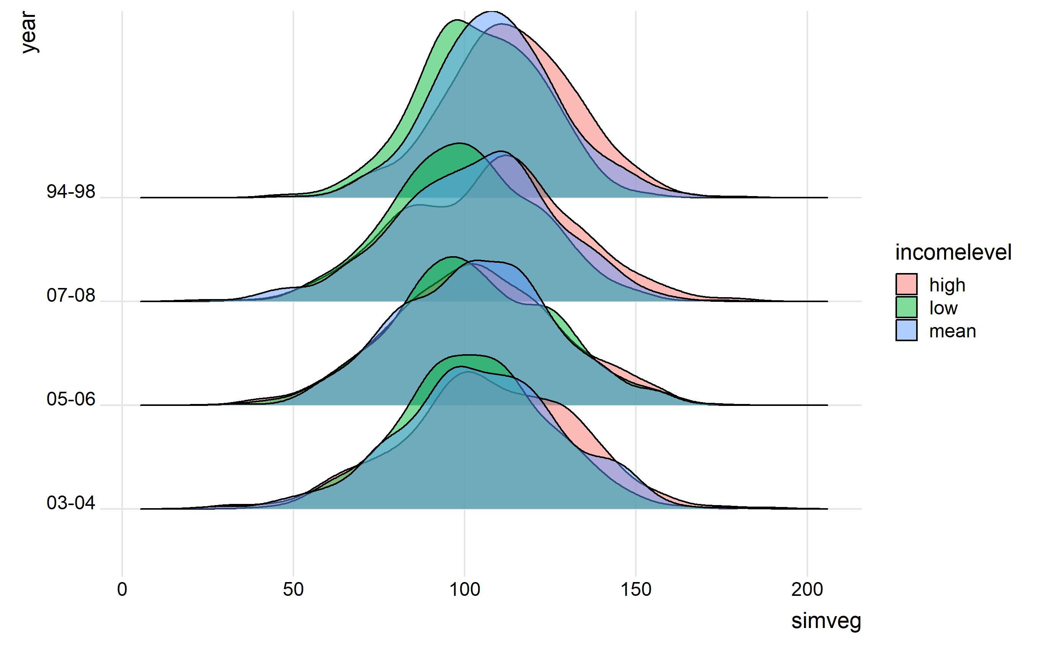
Simulated Vegetable Data

Slide 13
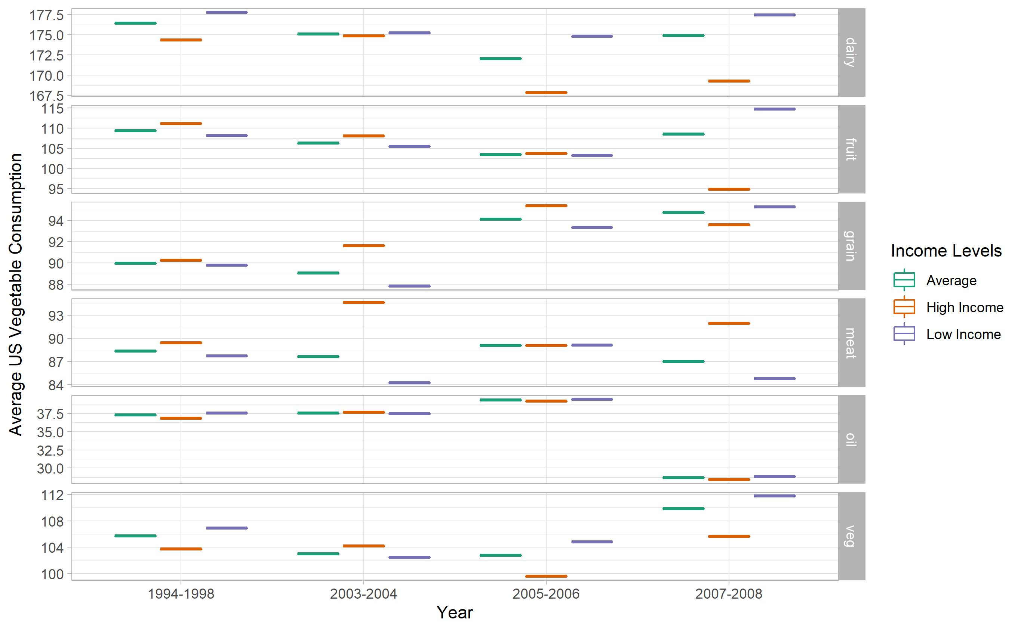
Notes:
Visual for high income, low income and average consumption by food type and year

Slide 14
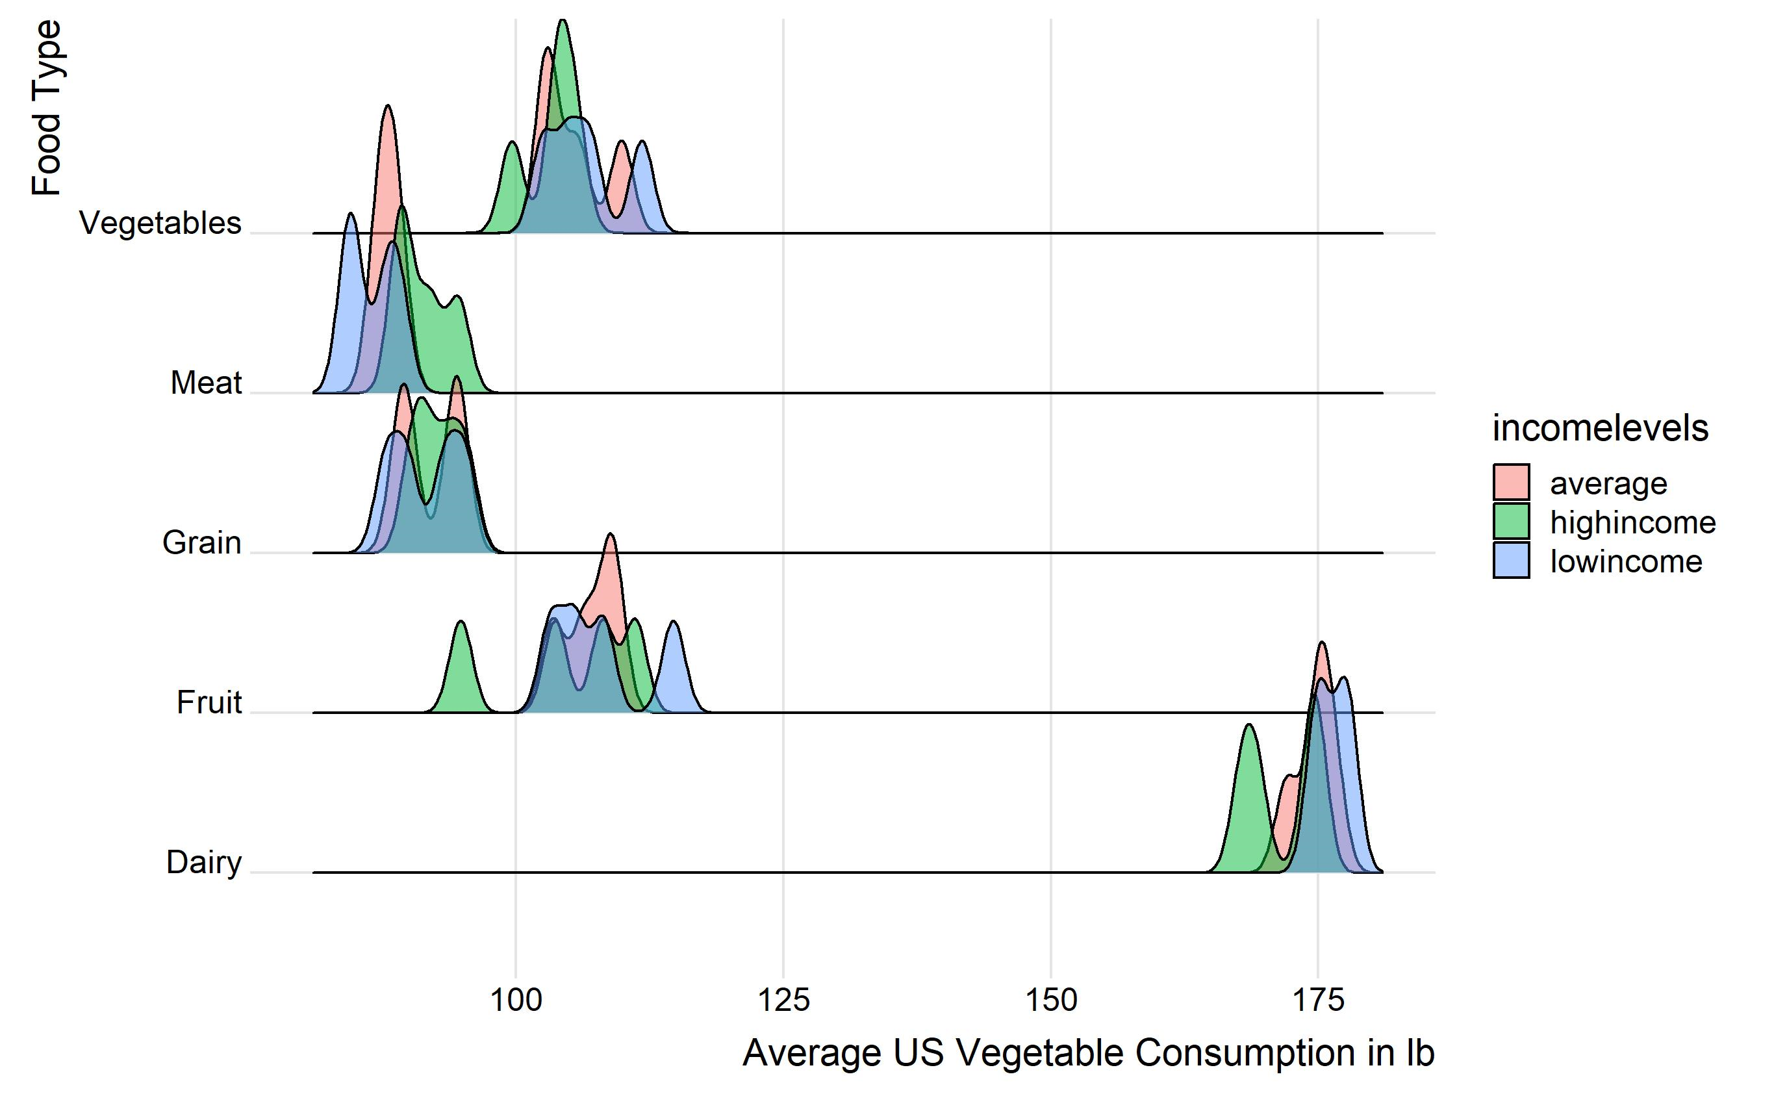
Notes:
These graphs compare low, average and high-income food consumption, across food types and years. The income levels appear to be grouped very closely, there is not a wide variation. High income is slightly higher for meat, and low income is slightly higher for vegetables and dairy most years. This is a surprising result. Expected lower amounts of fruit and vegetable consumption for low income.

Slide 15
Discussion
Annual consumption patterns were more stable than expected from year to year
Income levels are grouped closely
High income: ate more meat
Low income: ate more vegetables (3/4 years) and dairy (4/4 years)
Surprising results -> Simulated data predicted the opposite

Slide 16
Sources
Knight, L., & Riggs, W. (2010). Nourishing urbanism: A case for a new urban paradigm. International Journal of Agricultural Sustainability, 8(1–2), 116–126. https://doi.org/10.3763/ijas.2009.0478
Kulak, M., Graves, A., & Chatterton, J. (2013). Reducing greenhouse gas emissions with urban agriculture: A Life Cycle Assessment perspective. Landscape and Urban Planning, 111(1), 68–78. https://doi.org/10.1016/j.landurbplan.2012.11.007
R Core Team (2013). R: A language and environment for statistical computing. R Foundation for Statistical Computing, Vienna, Austria. URL http://www.R-project.org/.
Vermeulen, S. J., Campbell, B. M., & Ingram, J. S. I. (2012). Climate Change and Food Systems. Annual Review of Environment and Resources. https://doi.org/10.1146/annurev-environ-020411-130608
Wickham, Hadley. (2016) ggplot2: Elegant Graphics for Data Analysis. Springer-Verlag New York.
Wickham, Hadley (2017). tidyverse: Easily Install and Load the 'Tidyverse'. R package version 1.2.1. https://CRAN.R-project.org/package=tidyverse

Slide 17
THANK YOU!

